Slide 2

Pong

Slide 3
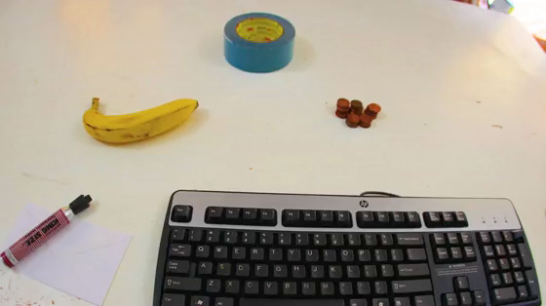

Slide 4
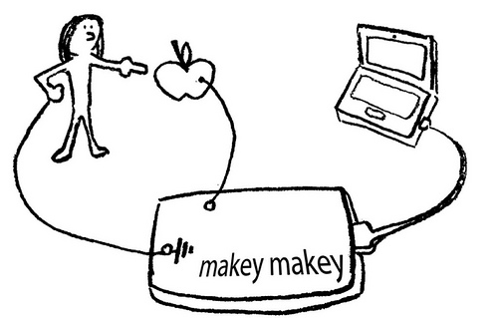
Controller bauen
http://www.kickstarter.com/projects/joylabs/makey-makey-an-invention-kit-for-everyone

Slide 5
BeiSpiel

Slide 6
BeiSpiele
schwer: bomberman, shooter, angry birds, pacman
mittel: asteroids, snake, breakout, towerdefense
leicht: autorennen, labyrinth, Pong

